Slide 1
Moving Forward
FY 2012-2013
[July 1, 2012 – June 30, 2013]
Annual Report

Slide 2
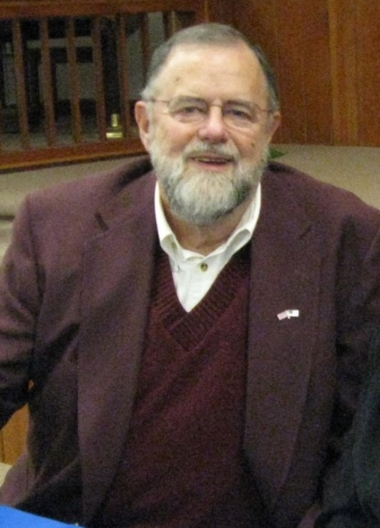
Current Board of Directors
Jimmy Walker, Chairman/ Victoria Jessup, Alternate
Mike Crouse, Vice Chairman
Paul Johnson, Treasurer
Sylvia Jessup, Secretary
Debra Jessup, Parliamentarian
Kevin Austin
Hassel Brown
Joyce Bryant
Mickey Cartner
Kelly Craine
Cindi Dixon
Beverley Essick
Eddie Harris/JoAnn Layell, Alternate
Essie Joyce
Shelby King
Ernest Lankford/Alan Boyles, Alternate
Richard Lasky
Mary Olvera
Terry Renegar/Dewey Hunt Jr., Alternate
Suzan Stephenson
Robert Strickland
Nancy Vera
Marion Welborn/ Jose Gonzalez, Alternate
Robert Wisecarver
YVEDDI helps thousands of people in the communities we serve to transform their lives for the better. Our very dedicated staff and strong governing body made up of public officials, private sector, and low-income representatives make every effort to offer comprehensive programs designed to meet the needs of people in our communities and have a positive and measurable impact on poverty.
We would like to take this opportunity to thank our many community partners and grantors for their continued support in our efforts to serve!
Jimmy Walker,
Chairman of the Board
“Many are called, but few are chosen.”
- Jesus, Matthew 22:14
2012-2013 Annual Report

Slide 3
Vision Statement
YVEDDI is the best Community Action Agency in North Carolina. Our caring professionals and Board members work in harmony as a team to make a positive difference, promote wholesome living and connect individuals and families to tools and resources that foster success and self sufficiency.
Table of Contents
Message from the Chairman of the Board………………. History…………………….……………………………….. Message from the Executive Director …………………… Community Services Block Grant (CSBG)………………. Displaced Homemaker Program…………………………. Domestic Violence/Sexual Assault………………………. Senior Enrichment Services………………………………. Senior Centers of Excellence…………………………….... Retired and Senior Volunteer Program (RSVP)……….... Head Start……………………………………………….... Migrant Head Start………………………………………. L. H. Jones Family Resource Center (FRC)……………… Public Transportation……………………………………. Weatherization…………………………………………… Yadkin Home Place Group Home, Inc…………………… Financials………………………………………………….. Funding Partners………………………………………….. | 2 4 4 5 7 8 10 12 14 15 17 18 19 21 23 24 25
Mission Statement
“Dedicated to improving the lives of individuals and families in Davie, Stokes, Surry, and Yadkin Counties through a variety of programs and partnerships to build stronger communities.”
2012-2013 Annual Report

Slide 4
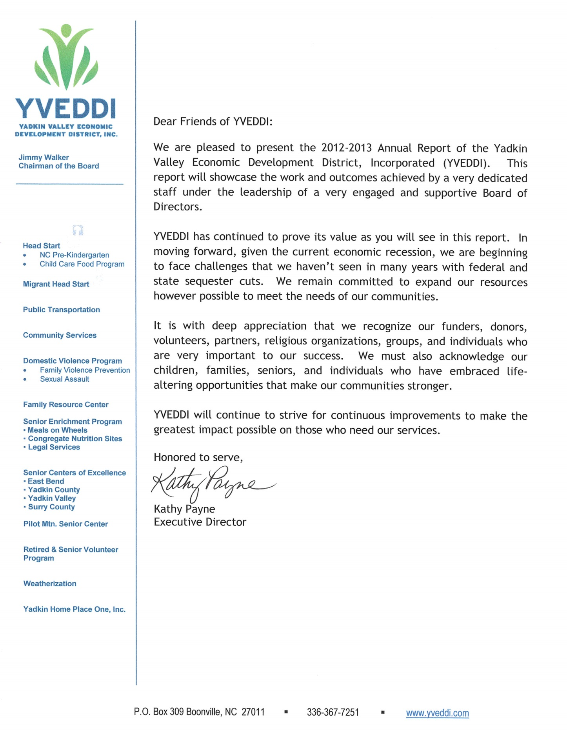
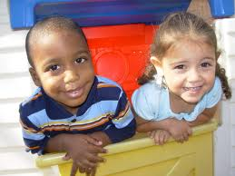
History
Organized in 1965, the YVEDDI is a private non-profit corporation designated as the local Community Action Agency which administers Human Services and Community Development Programs funded through Federal, State, County Governments, United Way/Fund agencies, and other resources. Laws, regulations, and funds limit all services provided.
Most programs operated by the YVEDDI must meet the Federal Poverty Index Guidelines, certain age criteria, or other guidelines.

Slide 5
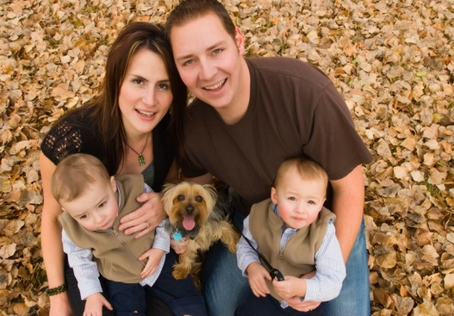
The primary long-range goal of our CSBG Program is to reduce the number of individuals/families in poverty (according to the Federal Poverty Index Guidelines) within a two-year period of time. This is done by providing comprehensive case management services and activities for families enrolled in the program. We empower customers through our Self-Sufficiency Program Philosophy that human services offered with supportive services and intensive success coaching create successful outcomes. On average, our participants’ wage rate increased by 4.7% upon completion of the program.
Community Services Block Grant Program (CSBG)
Assists individuals and families to help them overcome poverty and become economically self-sufficient.
Mr. T came to us after his marriage fell apart. He was devastated and living in his car. With determination and goals that he and his Success Coach set, Mr. T managed to obtain employment.
After 10 months in the CSBG Program, he obtained CNA I & II Certificates and Medical Technician Certificate, rented an apartment, and became self-sufficient by rising above the poverty level.
People Served FY 2012-2013
Total Planned (annual) | 60
Served | 156
Performance | 260%
Rose Above Poverty | 41
Obtained Employment | 20
Education/Training | 30
 | Goal | Served
Clients Enrolled - Davie | 9 | 12
Clients Enrolled – Stokes | 13 | 22
Clients Enrolled – Surry | 27 | 30
Clients Enrolled - Yadkin | 11 | 13
Totals | 60 | 77
Funded by the N. C. Department of Health and Human Services-Division of Social Services

Slide 6
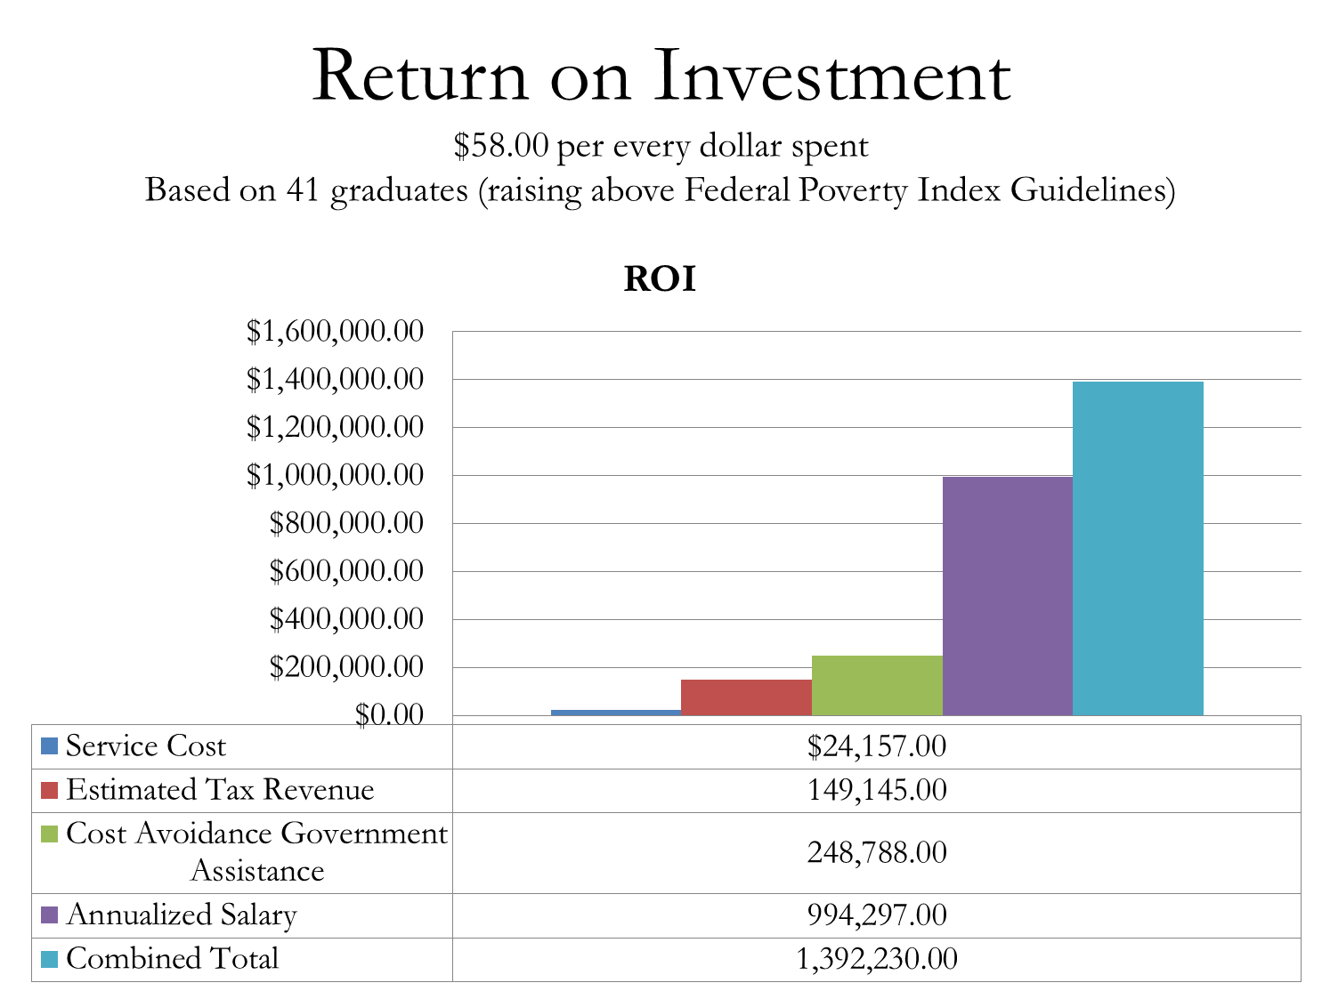
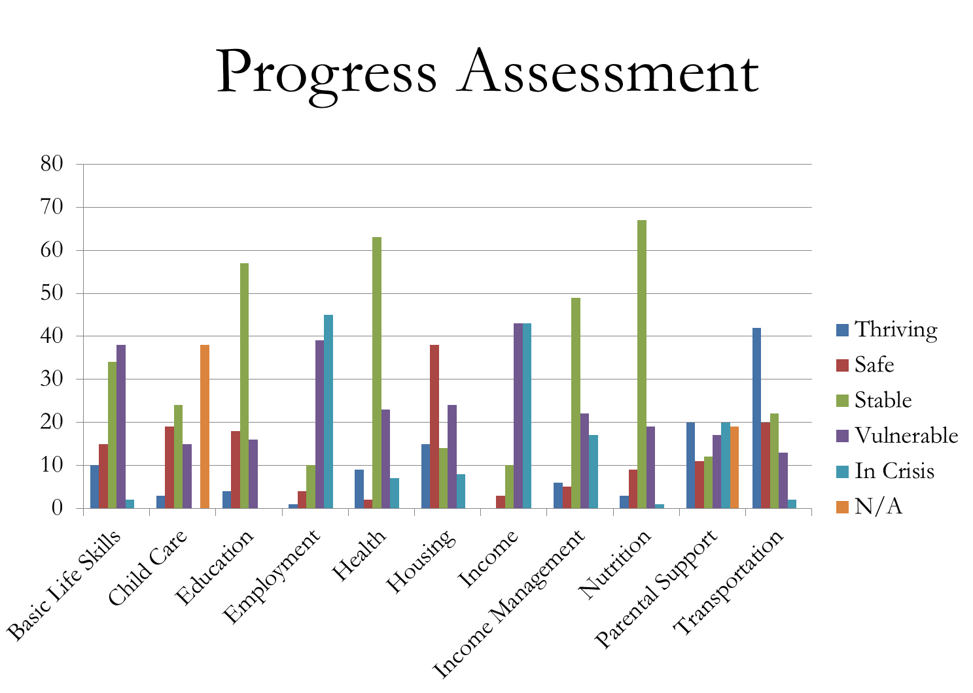
Community Services Block Grant Program (CSBG)

Slide 7
Displaced Homemakers are men or women who have worked in their own household and have provided unpaid household services. They must also be unable to secure employment due to lack of training, age, or experience or are unemployed or under-employed.
This program is different from general job-training and search programs as it strives to assist efforts being made by men and women to achieve economic self-sufficiency and emphasizes the identification of careers that will provide long-term support and a realistic, suitable income for families. The primary focus of this program is to provide the participants with support services that will prepare them for a career.
OUTCOMES FY 2012-2013
Displaced Homemaker Program
Provide support services to prepare clients for a career.
 | Goal | Served
Clients Enrolled - Davie | 12 | 9
Clients Enrolled – Stokes | 12 | 28
Clients Enrolled – Surry | 12 | 26
Clients Enrolled - Yadkin | 12 | 12
Totals | 48 | 75
Served | 69
Achieved Goals | 11
Individual Assessments | 64
Life Skills Training | 265
Tuition Assistance | 23
Job/Education Training | 173
Information and Referral | 90
Career Counseling | 138
Follow-Up | 514
Full-Time Jobs | 31
Part-Time Jobs | 39
Community College Placement | 39
Trades | 20
Other Training | 6
*FY 2012-2013 was YVEDDI’s first year operating the Displaced Homemaker Program.
Ms. AP was referred to the Displaced Homemaker Program by a Success Coach following her enrollment and participation in the CSBG program. She received assistance in furthering her education, obtaining more gainful employment, and working through her recent separation from her husband. AP is enlisted in the US Navy. The $300.00 a month she receives from enlistment is not sufficient to meet the needs of AP and her 3 small children. Since her enrollment in the DHP program, she has obtained several certifications through Forsyth Tech as a firearms instructor and Range Safety Officer. These will complement her military background. AP is now able to recognize her dream of opening her own private gun range, where she can educate people on the safety and proper use of firearms. Since enrollment, AP has also secured full-time employment through Remington Arms, earning an annual salary that is above the average living wage.
Funded by the N.C. Council for Women

Slide 8
Facts
One (1) out of every ten (10) Domestic Violence (DV)/Sexual Assault (SA) victims report their abuse. In the United States alone, DV results in a cost of $5.8 billion per year. Given the current economic situation, incidences of DV and SA continue to rise. It is our goal to increase awareness of these issues and steps that can be taken to decrease the number of DV/SA victims.
Domestic Violence/Sexual Assault Program
The mission of YVEDDI’s Stokes, Surry, and Yadkin County Domestic Violence/Sexual Assault (DV/SA) programs is to advocate for victims of sexual assault and domestic violence, to heighten awareness of sexual abuse and family violence, to advocate for the development and continuation of services and provide resources and referrals for DV/SA victims and survivors. We strive to not only provide services to those victims, but to change the traditional gender role norms.
An Elderly woman called the crisis hotline needing assistance in finding a safe shelter.
She had been physically assaulted by her boyfriend, who broke her ribs, arm and struck her in the face. We were able to provide her with a hotel room for one night until we could get her into a shelter in Wilkes County the following day. We were also able to work with law enforcement, the shelter and other resources to provide her with safety.
The woman later called our office and said her abuser had been arrested and that she would like to take out a 50B Domestic Violence Protective Order against him. We went to the shelter and provided her with transportation back to the Surry County Clerk of Court’s office so that she could fill out the protective order paperwork. She was then granted a temporary order and also filed criminal assault charges against him.
We then coordinated efforts with Legal Aid of North Carolina to provide her with legal representation to obtain the one-year protective order. Her order was continued several times but stayed in place during the many court proceedings. On her final court date, all signs of the abuse were gone. Her physical injuries had healed, and she was becoming more and more independent and empowered to end the cycle of violence that she had been enduring for more than seven years. Legal Aid was there to represent her.
The abuser was found guilty of assault on a female, and the client was granted a one-year protective order. By being brave enough to take that first step to end the abuse, the woman was able to free herself and continues to grow in strength.
Funded by: N.C. Council For Women, United Fund of Surry, Yadkin Valley United Fund, Yadkin County United Fund, United Fund of Stokes County, County of Stokes, County of Surry, County of Yadkin, N.C. Department of Health and Human Services , and N.C. Department of Crime Control/Governor’s Crime Commission

Slide 10
Meals on Wheels
Nutritionally-balanced lunch-time meals are delivered five (5) days a week, Monday through Friday, to eligible homebound residents 60 years of age and older.
The meals are provided to help maintain or improve the health of seniors, thereby enabling them to stay in their own homes for as long as possible.
Meals are delivered by volunteers who are reimbursed for use of their personal vehicles.
Congregate Nutrition
Nutritionally-balanced noon-time meals are served five (5) days a week, Monday through Friday, to seniors 60 years of age and older at the following Nutrition Centers:
Dobson Jonesville
Low Gap Pilot Mountain
Mount Airy East Bend
Yadkinville
Transportation
Medical and general transportation is available to eligible persons age 60 and older.
Transportation is provided for seniors attending Congregate Nutrition Centers in Davie, Surry, and Yadkin counties and for supportive services for these centers.
Legal Services
Legal services assistance is available to Surry, Stokes, and Yadkin County residents who are 60 years of age and older.
Services performed under this program are civil, non-fee producing. Examples are:
- Wills
- Power of Attorney
- Deed Transactions
- Consultations
Services are provided by local participating attorneys in each county.
Senior Enrichment Program
Provides Meals on Wheels, Congregate Nutrition, Legal Services, and Transportation for seniors 60 years of age and older.

Slide 11
We recently assessed a gentleman for the Meals on Wheels program because his daughter – his only child with whom he had been living – was considering moving. After struggling for months to find employment, she had received an offer for an out-of-state job but was hesitant to accept it for fear that her father would not be able to live alone due to his health issues.
He suffered from Parkinson’s disease and diabetes, and because of diabetic neuropathy, was unable to stand long enough to prepare his own meals. Though he had encouraged his daughter to take the job so she could provide for her family, he refused her request to move with them.
“Surry County had been his home for many years,” her father insisted when she tried to persuade him to change his mind. His wife was buried there, he said, and he had a close relationship with his church family. Worried about her father, the man’s daughter called one of YVEDDI’s Senior Enrichment staff members asking about the Meals on Wheels program.
Though she knew that his friends and church family would take him to doctor appointments, pick up his prescriptions, and help with his basic shopping, she was concerned that he would be alone for days at a time and because he was unable to cook, would only eat sandwiches and snack food. Through the Meals on Wheels program, she was able to accept the job offer and move knowing that he would receive a warm, nutritious lunch five days a week.
In addition to providing a well-balanced meal every weekday, the Meals on Wheels program also gave her father more connection to the outside world. Talking to the volunteer drivers who deliver the meals gives him something to look forward to and makes him feel less alone.
Funded by Piedmont Triad Regional Council, County of Davie, County of Yadkin, County of Surry, Davie County United Way, United Fund of Surry County, Yadkin County United Fund, participant contributions, and fundraisers
Senior Enrichment Program Statistical Report

Slide 12
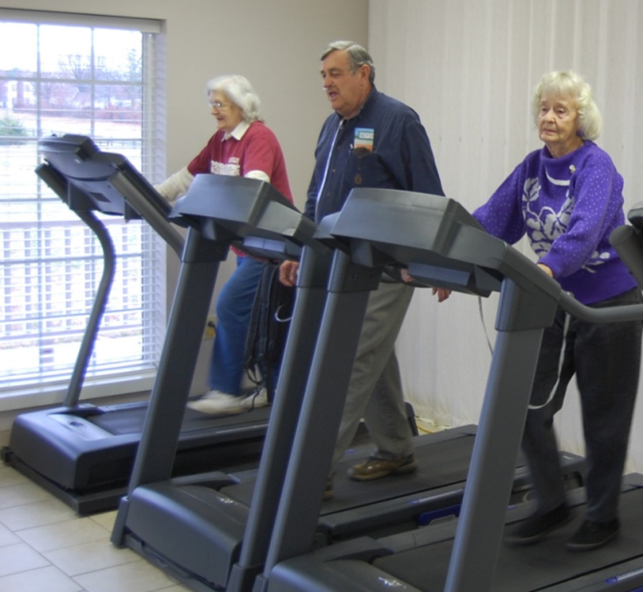
The YVEDDI Senior Centers are multi-purpose centers which address the needs of the older adult 50 and up. Programs are offered to promote health and wellness, education, recreation, socialization, and volunteerism through extensive collaboration with the community.
Each center is certified by the North Carolina Division of Aging and Adult Services as a Center of Excellence and operates under the guidelines established by the National Institute of Senior Centers. Annual assessments are conducted by the Piedmont Triad Regional Council, the Area Agency on Aging operating under the North Carolina Department of Health and Human Services, Division of Aging.
Information and referrals are provided to senior adults on an as-needed basis. The centers are open Monday through Friday from 8:00 a.m. to 4:30 p.m. and offer occasional evening and weekend activities and events. The centers are closed on holidays and weekends when activities, events and programs are not scheduled.
Senior Centers of Excellence
are multi-purpose centers which address the needs of older adults and promote socialization, recreation, health and wellness, education, and volunteerism.
The five (5) Centers of Excellence operate in the towns of East Bend, Yadkinville, Jonesville, Mount Airy and Pilot Mountain.
Featuring Doris Royer, Randy Crawford and Irene Matthews
County | Clients Served
Surry | 17,083
Yadkin | 42,566
Total | 59,649
Average daily attendance: 62 per center
Funded by the N.C. Division of Aging and Adult Services, Piedmont Triad Regional Council, Home and Community Care Block Grant for Older Adults, United Fund of Surry County, County of Surry, County of Yadkin, Yadkin County United Fund, Yadkin Valley United Fund, and fundraising.

Slide 13
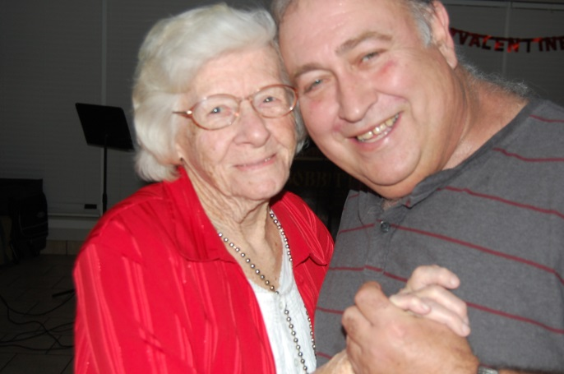
Moments of Joy
Ms. Margie Smith is a lively, energetic 96-year-old who has been attending the YVEDDI’s East Bend Senior Center since April of 2000. Ms. Smith enjoys eating lunch and participating in fun activities with her friends at the center.
Ms. Smith first began attending the senior center to participate in weekly Rook games. She soon added many of the Senior Center’s other regularly scheduled activities to her routine, including the Quilting Guild, paper bead classes, exercise classes and bingo. She is also a member of the Painting Club and facilitates the Crochet Club.
Ms. Smith says, “I feel so much better during the week than I do on the weekends. I have stuff to look forward to during the week. The weekends are depressing because I just sit and think. It gets me down.”
Her granddaughter is grateful to YVEDDI for operating the Senior Center in their community and credits its programs for keeping her grandmother healthy, independent, and active.
The Senior Center helps Ms. Smith to feel connected and supported. Her life and overall sense of well-being are improved because of the fellowship and support she receives there.
Margie, who is deeply loved by her family and friends, is an inspiration to all. She is truly young at heart!
Ms. Margie’s first slow dance
“We don’t stop playing because we grow old; we grow old because we stop playing.”
Senior Centers of Excellence Success Story

Slide 14
Retired and Senior Volunteer Program (RSVP)
Recruits, places, and supports older citizens in humanitarian pursuits affecting measurable improvements in community life in Davie, Surry, and Yadkin counties.
RSVP
RSVP is one of the largest volunteer networks in the nation for people ages 55 and older. It gives them an opportunity to use their talents and the skills they’ve learned over the years and even develop new ones while serving in a variety of volunteer activities within their communities.
The Meals on Wheels program is more than just a meal.
A 75-year-old Meals on Wheels client, who had been paralyzed from a stroke, was outside on her scooter one day last summer when she fell off onto the ground and could not get up. She shouted for help, but her voice was too frail for any of her neighbors to hear her.
A YVEDDI volunteer driver arrived with her meal at 11 a.m. and became concerned when he saw her dog outside as it was usually inside with her. He knocked on the door and became even more concerned when she didn’t answer.
The driver was walking around to the back door when he heard the cries of the woman. He helped her back onto her scooter and guided her inside, where he got her a glass of water, applied medicine to her sunburn, and because she was so weak, helped her with the meal.
Thanks to all our volunteer drivers who go the extra mile.
County | Stations | Volunteers | Clients Served | Volunteer Hours
Davie | 5 | 91 | 2,863 | 7,357.25
Surry | 20 | 204 | 9,206 | 28,635.25
Yadkin | 13 | 80 | 2,307 | 8,107.25
Total | 38 | 375 | 14,376 | 44,099.75
Due to federal guidelines, RSVP volunteers can only service non-profit agencies.
Funded by the North Carolina Department of Insurance, Senior Health Insurance Information Program (SHIIP), Senior Medicare Patrol (SMP), County of Davie, County of Surry, County of Yadkin, Davie County United Way, Yadkin County United Fund, and United Fund of Surry

Slide 15
Program Mission
The YVEDDI Head Start staff will continuously establish and evaluate program practices that will bring about the greatest success for children and families.
Program Description/Purpose
In 22 classrooms in 15 sites across four counties, Head Start serves 385 children ages 3 to 5, preparing them for kindergarten. Staff members also work with their families to promote self-sufficiency. Comprehensive services provided include child medical and dental services, individualized family services, and transportation, as feasible.
YVEDDI Head Start prepares children for kindergarten by helping them to develop the skills they need to be successful upon entering the public school system. We also work with parents to make sure they are aware of what their children need to succeed when they transition to kindergarten. All of the Head Start facilities hold a five-star license from the N.C. Division of Child Development and Early Education, signifying them as offering the highest possible quality of child care in North Carolina.
Our Educational Program
We place intense focus on school readiness by involving teachers, the children and their families. Our educational program focuses on physical health, social and emotional development, literacy, mathematics, science, creative arts, language expression, social studies, logic and reasoning, and English language development.
We work with the public school system and other entities to ensure that children with diagnosed disabilities receive the necessary services to help them succeed. During the 2012-2013 school year, we served 57 children with diagnosed special needs.
Head Start
Prepares children for kindergarten in 5- Star licensed centers and works with the families to promote self-sufficiency.

Slide 16
Our curriculum is aligned with the North Carolina Early Learning Standards for preschoolers, and we offer comprehensive assessment to measure children’s development three times a year. The results of our assessments are used to develop individual objectives for each child and shape our lesson planning. Detailed reports about each child’s development are shared with parents so that learning at home can be reinforced. In the 2012-2013 school year, we showed an overall gain of 23.17% in the development of our children.
Our program works with the Davie, Elkin City, Mount Airy, Stokes, Surry, and Yadkin County school systems to ensure a smooth and easy transition to kindergarten. Each year, our program submits detailed educational information about children to their respective school systems to help their new teachers determine their current development level.
Our Families
In 2012-2013, our program served a total of 479 preschool children (representing 429 families) in our service area: Davie-68, Stokes-78, Surry-211, and Yadkin-122. The families of 350 of these children fell below the 100% federal poverty level. There were 111 children enrolled in their second year of services with our program. Of the 429 families served, 220 were comprised of two parents while 209 were comprised of one. Our program helped families find housing, jobs, emergency crises intervention, educational opportunities, and job training.
Medical Services
One hundred percent of our children received medical and dental exams, had medical and dental homes at the end of enrollment, and received preventive dental care. One hundred percent of children that were referred received Mental Health Services.
Transportation
We provided transportation for 241 of our children last year.
Parent Involvement
Our program had a total of 319 volunteers and held 135 parent meetings during the 2012-13 school year. Our program is governed by a policy council comprised of current and former Head Start parents and other representatives from the communities we serve.
Our Staff
Eighty-six percent of our lead teachers hold bachelor’s or master’s degrees in birth-kindergarten education. One hundred percent of our assistant teachers hold a one-year certificate or an AAS degree in early childhood.
Funded by the U.S. Department of Health and Human Services, and N.C. Pre-Kindergarten
Head Start Statistical Report

Slide 17
The YVEDDI Migrant Head Start program operates from June through October for children ages 6 weeks to 5 years. The program provides comprehensive family support and child development services for 45 children of migrant farm workers who have moved to Surry or Yadkin Counties within the last 24 months; and for seasonal migrant families who no longer move but continue to work in agriculture as their main source of income.
Migrant
Head Start
Center Information
One center located in Boonville, N.C.
4 classrooms
A-4 star licensed center that operates June-October
Families
Funded enrollment 38
Number of children served 40
Disabled children served 7
Below poverty guidelines 100%
YVEDDI’s Migrant Head Start program is committed to strengthening the growth and development of the enrolled children and their families by respecting their culture, honoring their confidentiality and sharing the decision-making to ensure their well being.
Health Services
Physicals 40
Immunizations 40
Dental services 38
Mental health assessments 40
Teacher Education
Baccalaureate degree 1
Associate degree 1
Child development associates degree 6
Child Outcomes
Three times per season, we formally assess and report the developmental progress of each child in our program. Some of the learning domains include: social and emotional development, physical health and development, language development, cognitive, literacy and mathematics.
Overall Gains by Age Group:
Infants – 7.90%
Toddlers – 9.28%
Preschoolers – 10.26%
Ages of Enrolled Children
6 weeks-12 months 2
1 year olds 4
2 year olds 8
3 year olds 9
4 year olds 14
5 year olds 3
Funded by East Coast Migrant Head Start Project
Total # Children Served from Surry County | 32
Total # Children Served from Yadkin County | 18

Slide 18
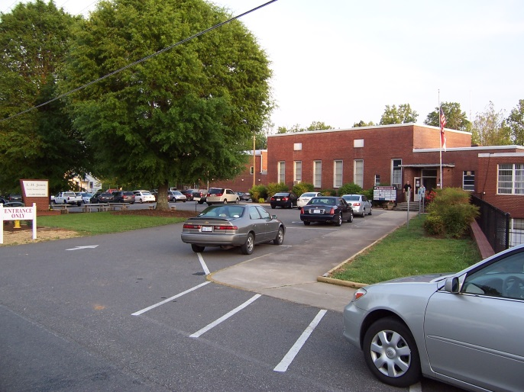
Program Description/Purpose
The YVEDDI Family Resource Center (FRC) is a multi-purpose center which addresses various needs of the community. Programs are offered to promote health and wellness, education, recreation, socialization, and volunteerism.
The Family Resource Center coordinates and partners with local agencies, colleges, schools, businesses, and individuals to offer a variety of services and opportunities that appeal to the interests and needs of the local community.
L.H. Jones Family Resource Center (FRC)
Working to make a difference in the lives of local individuals and families through programs that addresses their various needs.
2012-2013 FRC Facility Improvements
Upper Level
Remodeled one restroom
Added new carpet, paint, and lobby furniture
Lower Level
New paint in cafeteria
Hallway and bathroom repainted
New fluorescent light fixtures
Parking Lot/Safety Upgrades
New signs, striping, and concrete curbs
Outside
Replaced decayed facial boards
Landscaping improvements
Current Occupants
YVEDDI Public Transportation
YVEDDI Community Services Block Grant Program
YVEDDI Senior Enrichment Program
YVEDDI RSVP
YVEDDI Head Start
YVEDDI Senior Center
J. J. Jones Alumni
LIFESPAN
Workforce Investment Act
Yokefellow Ministries
Surry Community College
ESL Preschool
Surry ARC
We are pleased to welcome our newest occupant, Grace’s Closet, which will be providing free clothing and shoes to the community.
Service Statistics
A total of 199,020 people participated in activities and/or services offered at the Family Resource Center.
Funded by County of Surry, fundraisers, community users, and occupant agencies/organizations

Slide 19
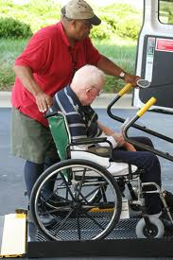
YVEDDI Public Transportation is a regional transportation system providing a variety of transit services and programs to groups and individuals in Davie, Stokes, Surry, and Yadkin Counties.
Some of the types of trips provided are: congregate nutrition, special events, and youth activities. Contracted services are available for elementary, developmental and preschool transportation; trips for medical services; shopping for daily living supplies; and transportation to work. Services are available to people with transportation challenges, including the elderly and disabled, veterans, and others. We also operate a rural general public program for a small fee as funding and vehicles are available.
To improve service delivery and help manage its more than 800 trips per day, YVEDDI’s transportation program applied for and received a grant to install advanced scheduling software in April 2013. Operating with a consolidated, centralized scheduling system allows the department to provide the most trips possible with the drivers and vehicles available and gives transportation employees the ability to generate computerized data for service planning and reports for grantors. When fully implemented with onboard computers, the system will lower expenses while providing more trips per day for our citizens.
Public Transportation
Mission Statement:
To serve the mobility needs of a four-county region by using all means of mobility available.
Funded by the N.C. Department of Transportation, Federal Transit Administration, County of Davie, County of Stokes, County of Surry, County of Yadkin, user fees, and contract revenues

Slide 20
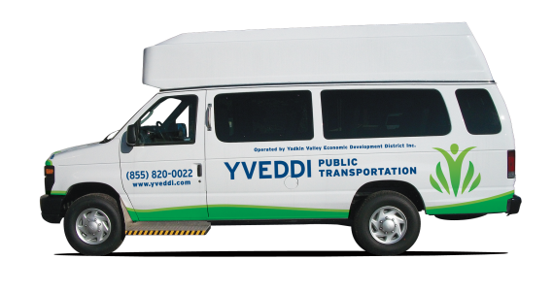
Vehicle Types
Sedans
Mini Vans
Wheelchair Vans
Light Transit Buses (20’-25’)
Public Transportation Statistical Report
Funded by N.C. Department of Transportation, Federal Transit Administration, local counties and user fees.

Slide 21
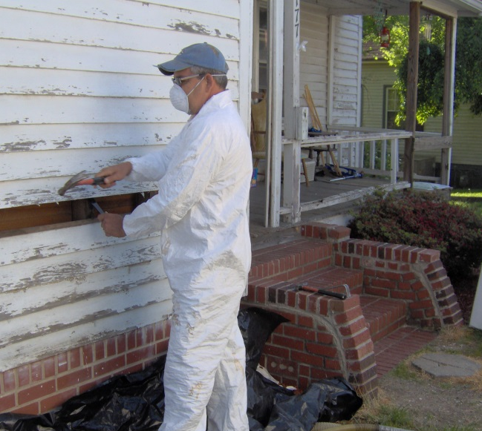
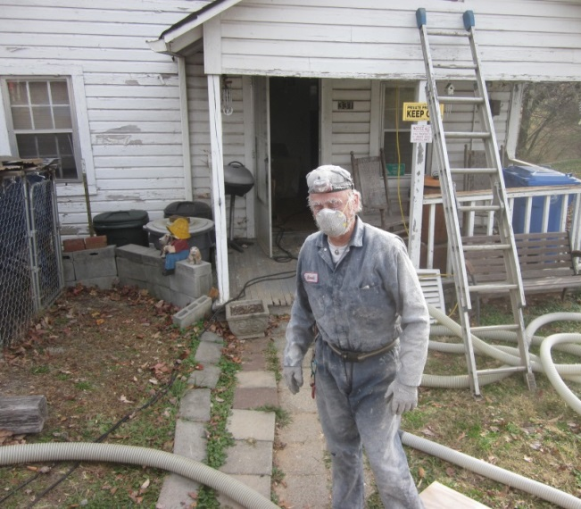
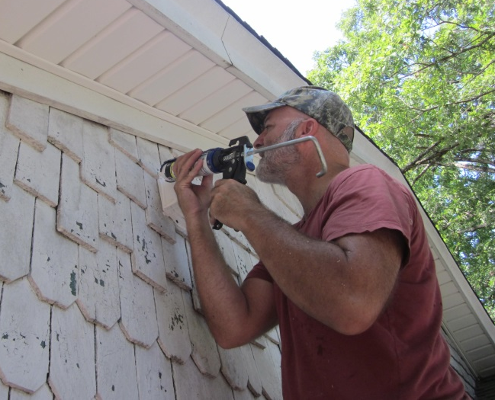
In 2012-2013, 25 homes were weatherized, improving the lives of 51 people.
Weatherization
Assistance Program
Recently, a 76-year-old resident of Yadkin County applied for weatherization services. Her home had been built in 1940 when building materials were scarce because of World War II. The home had no insulation and its 16-year-old heat pump had stopped working three months before.
The homeowner was told it would cost more than $4,000. Her monthly income of $694 would not stretch far enough to have the heating system replaced as it took every penny she made just to buy food and medicine.
YVEDDI’s weatherization crew installed R-11 insulation in the walls, R-19 insulation in the flooring, and R-38 insulation in the attic. The water heater was insulated, all of the duct work was sealed with mastic to make it airtight, compact fluorescent light bulbs were installed, and a bath fan was installed and vented outside to remove excess moisture and humidity from the home.
Additionally, YVEDDI’s HARRP program replaced her 16-year-old heat pump. The homeowner was very grateful and said there was no way she could have ever had this done on her own.
The Weatherization Assistance Program is designed to weatherize the homes of low-income families, making the homes more energy efficient and easier to heat and cool.
Funded by the N.C. Division of Commerce Energy Division, Department of Health and Human Services, and County of Surry

Slide 22
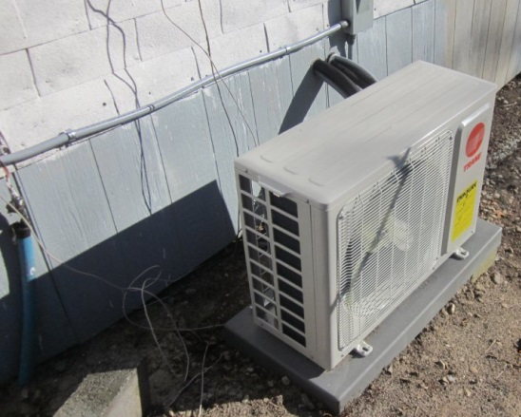
The Heating and Air Repair and Replacement Program (HARRP) repairs or replaces heating and cooling systems for low-income households. In 2012-2013, YVEDDI was able to repair or replace the heating/cooling systems in 17 homes, improving the lives of 23 people.
Wait List - 4
Average Cost Per Unit $2,788
Funded by the N.C. Division of Commerce Energy Division, Department of Health and Human Services, and County of Surry
Weatherization Program

Slide 23
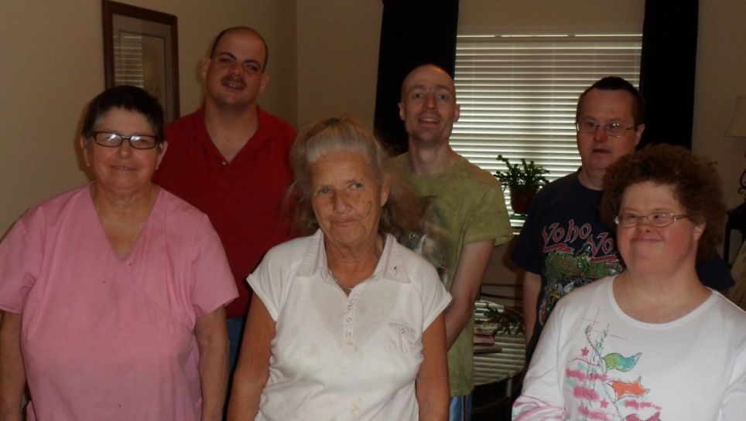
The Yadkin Home Place One is licensed by the State of North Carolina and provides supervised residential services to six developmentally disabled (IDD) adults.
Our clients are provided with targeted case management services, day activities, transportation, and related services designed to assist them in reaching short-term objectives and long-range goals, emphasizing assistance to clients in maximizing full development potential.
One of our residents moved into Yadkin Home Place One after living at home with his parents. Upon arriving, he needed the staff’s assistance with many of his daily skills such as dressing himself and chores like making his bed and sorting his laundry.
With the help of the group home’s caring staff, the resident is now able to express pride in his skills and exhibits an improved sense of self when he dresses himself or puts on new pillowcases and sorts his laundry. He loves to tell the staff, fellow residents and his parents, “I did it all by myself!!”
This resident continues to need supervision, but staff members allow him to do as much of any task as he can to build on his success and increase his self-esteem.
Yadkin Home Place One
The Yadkin Home Place Six, Inc. Board of Directors is the founder and fundraising arm of this home. Board members are from various parts of Yadkin County and are deeply committed to identifying funding resources to meet the needs of adults with disabilities receiving residential services.
Yadkin Home Place Six, Inc.
Board Members
Bob Adams, Tony Gentry, Jerry Carlton, Marty Driver, Mildred Carter, Sandie Grant, Linda Gough, Kim Matthews, Faye Diachenko, Lindsey Craven and Randy Warden
Funded by Yadkin Home Place Six, Inc., Yadkin County United Fund, Partners Behavioral Health Management, Resident Benefits, and fundraisers

Slide 24
*Financials
Expense Source | Dollar Amount | Total %
Domestic Violence | 334,620.00 | 3%
Head Start | 3,654,042.06 | 34%
Self Sufficiency Related | 371,960.32 | 3%
Senior Enrichment | 1,015,523.76 | 10%
Transportation | 4,575,892.63 | 43%
Weatherization | 247,027.24 | 2%
Other | 450,785.90 | 4%
Administration | 645,190.71 | 4%
 | $11,295,042.62
Funding Source | Dollar Amount | Total %
Operations and Fund Raising | 5,024,073 | 45%
FED | 4,991,982 | 45%
NC | 708,292 | 6%
Local Entities | 387,091 | 5%
In-kind | 93,892 | 1%
TOTAL INCOME | $11,205,329
*These figures are presented based on the Modified Accrual Basis of accounting, and have not been audited by an independent auditor. They are meant as approximations of how Yadkin Valley Economic Development District, Inc. (YVEDDI) performed in its Fiscal Year ending June 30, 2013 and should be used and/or quoted as such. YVEDDI assumes no liability for the use of these figures for any purposes other than their intended use as approximated Revenues and Expenses.
There were no findings in the audit for the period ending June 30, 2012
There were no findings in the audit for the period ending June 30, 2013 (Audit completed by Preston Sims & Darden PA)

Slide 25
Funding Partners Contract Revenues County of Davie County of Stokes County of Surry County of Yadkin Davie County United Way East Coast Migrant Head Start Project Federal Transit Administration Home and Community Care Block Grant for Older Adults N.C. Pre-Kindergarten N.C. Council for Women N.C. Department of Crime Control/Governor’s Crime Commission N.C. Department of Health and Human Services N.C. Department of Insurance N.C. Department of Transportation N.C. Division of Aging and Adult Services | N.C. Division of Commerce Energy Division Occupant Agencies/Organizations Partners Behavioral Health Management Participant Contributions Piedmont Triad Regional Council Seniors’ Health Insurance Information Program (SHIIP) Senior Medicare Patrol (SMP) State of North Carolina United Fund of Stokes County United Fund of Surry County User fees U.S. Department of Health and Human Services – USDA Childcare and Adult Food Program Yadkin County United Fund Yadkin Home Place Six, Inc. Yadkin Valley United Fund
Disclaimer
“Restricted grants, fundraisers, and donations only support designated or specified projects or programs allowed by the contributor; resources cannot be disbursed or comingled with other projects or programs to offset any expenditures.”

Slide 26
48
years of service
Serving Davie, Stokes, Surry and Yadkin counties

